Slide 1
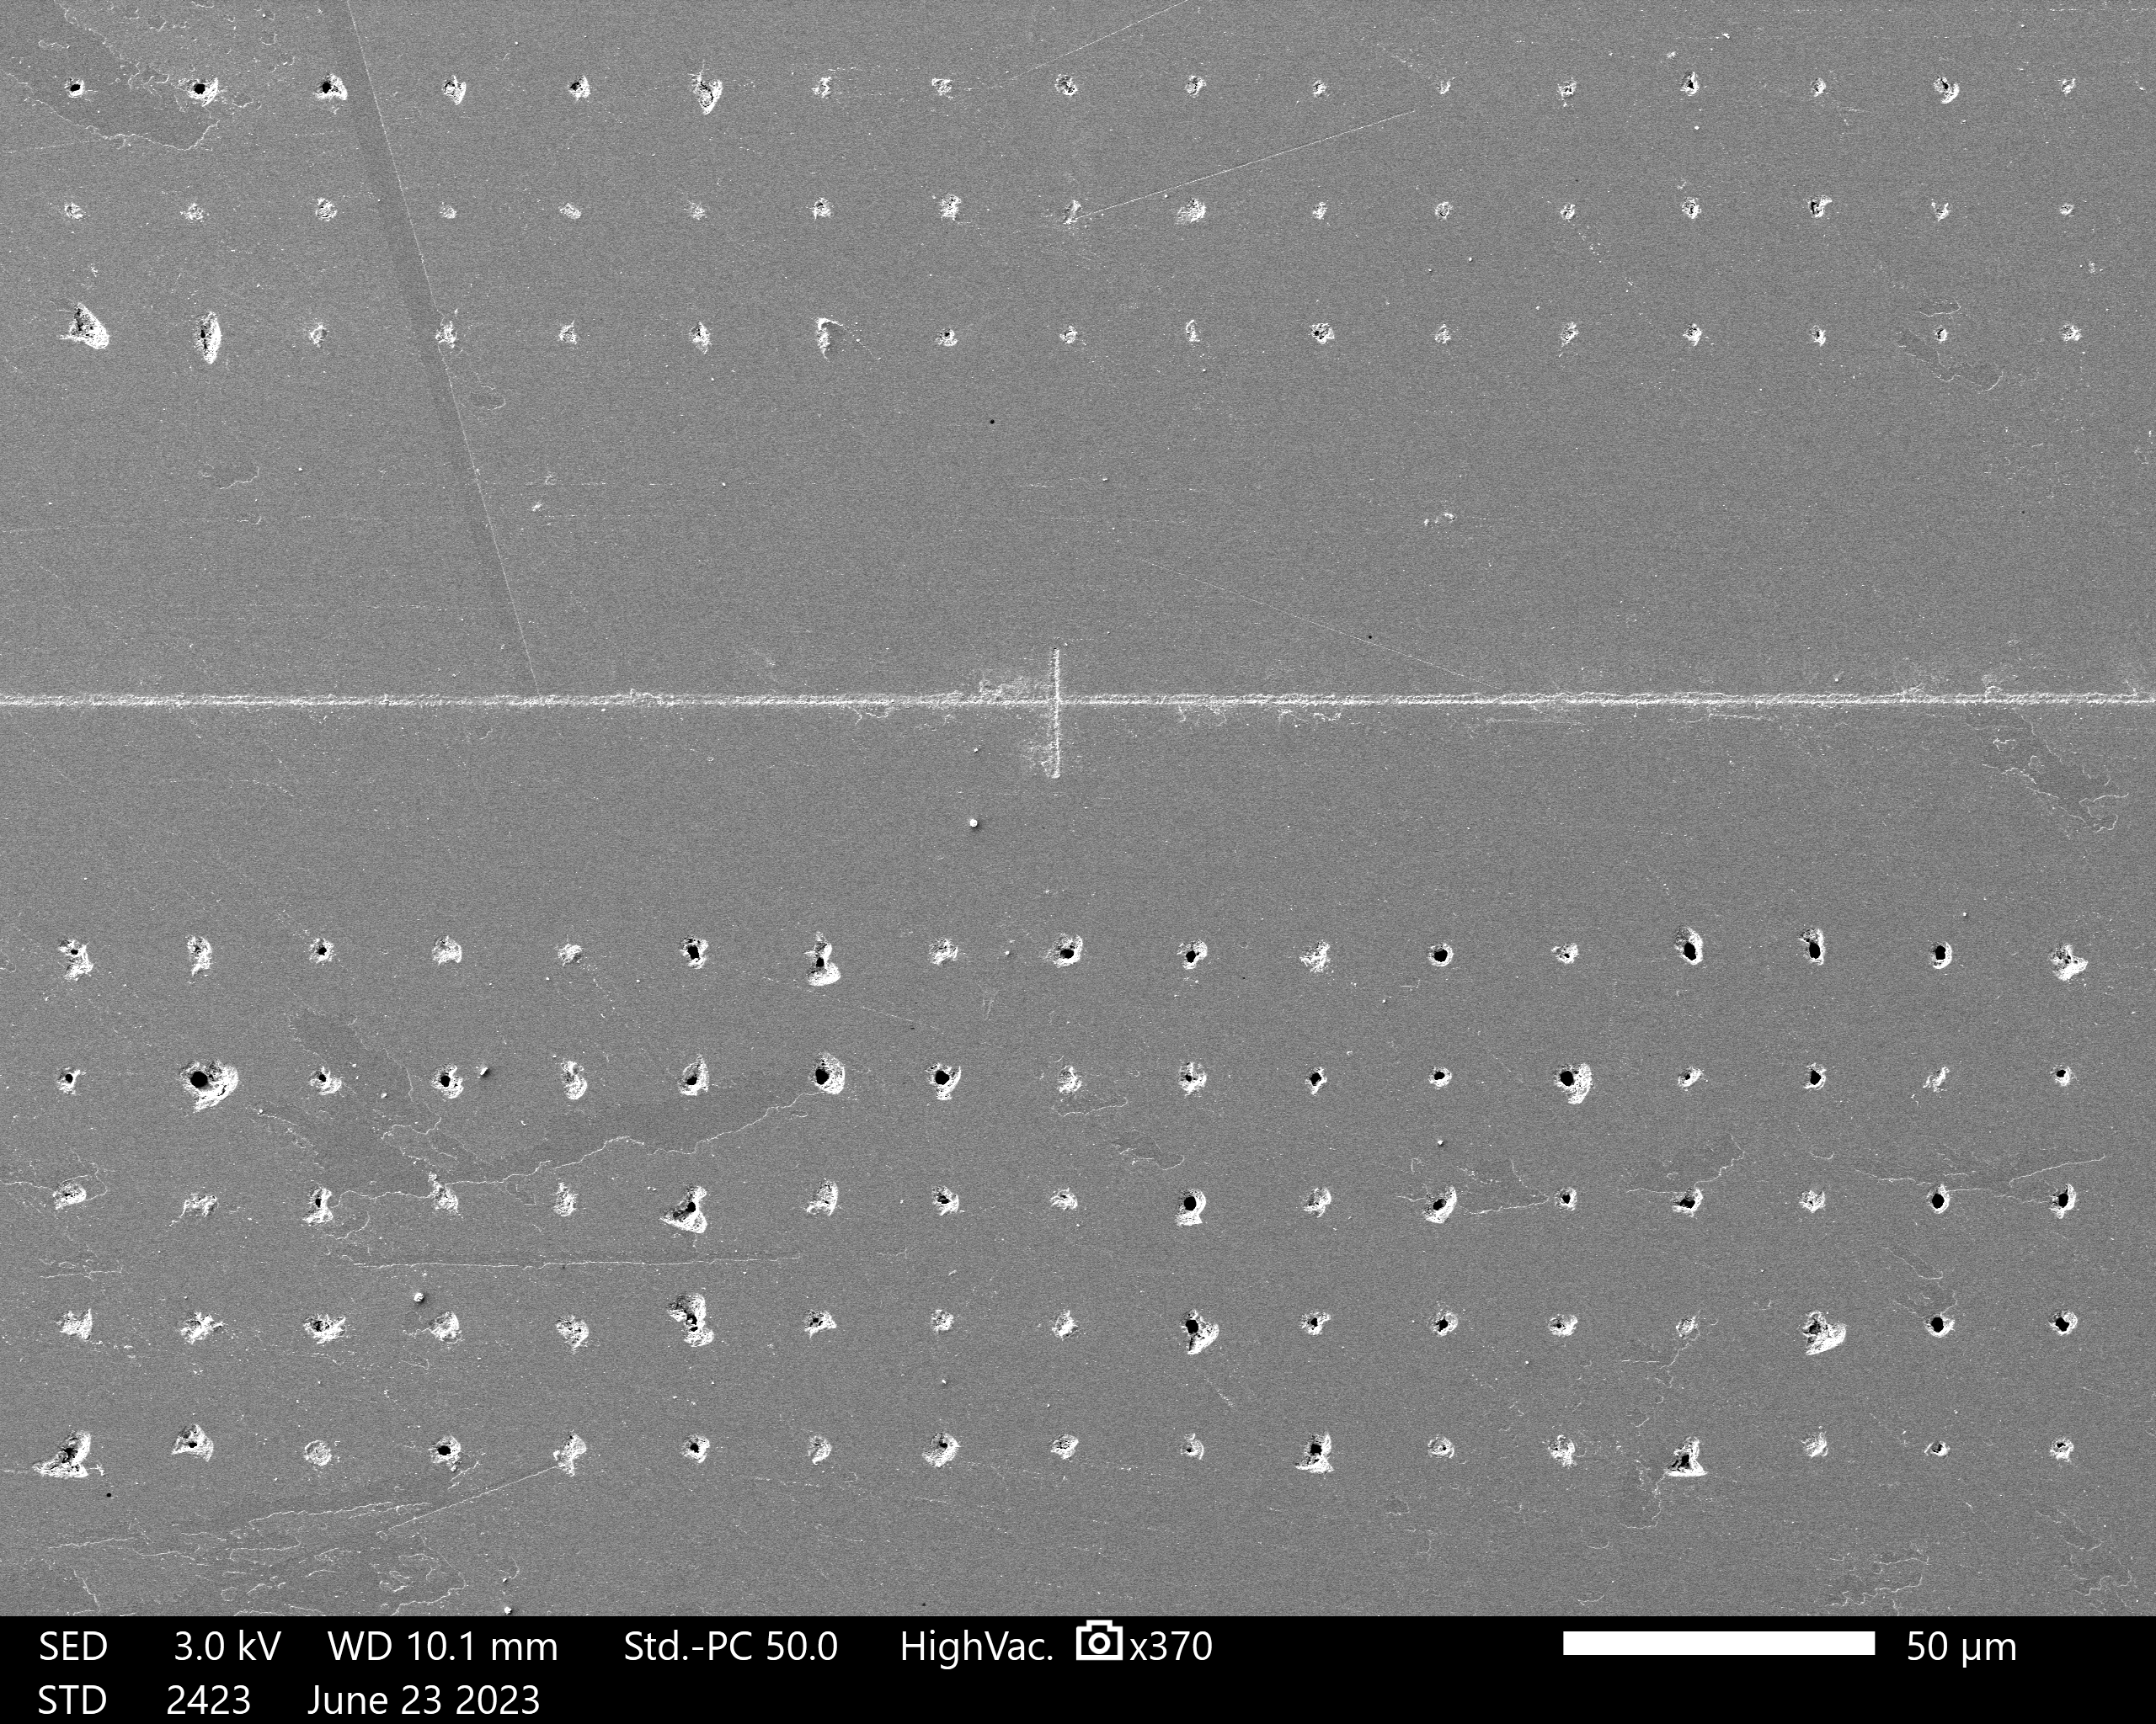
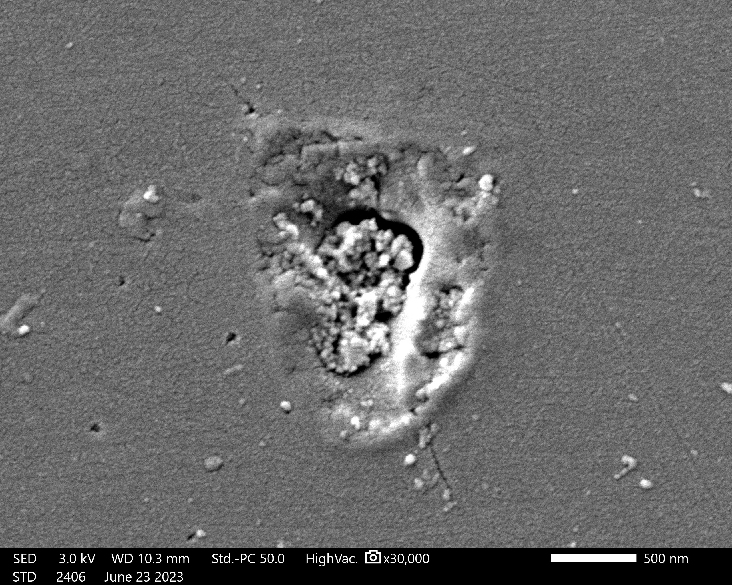
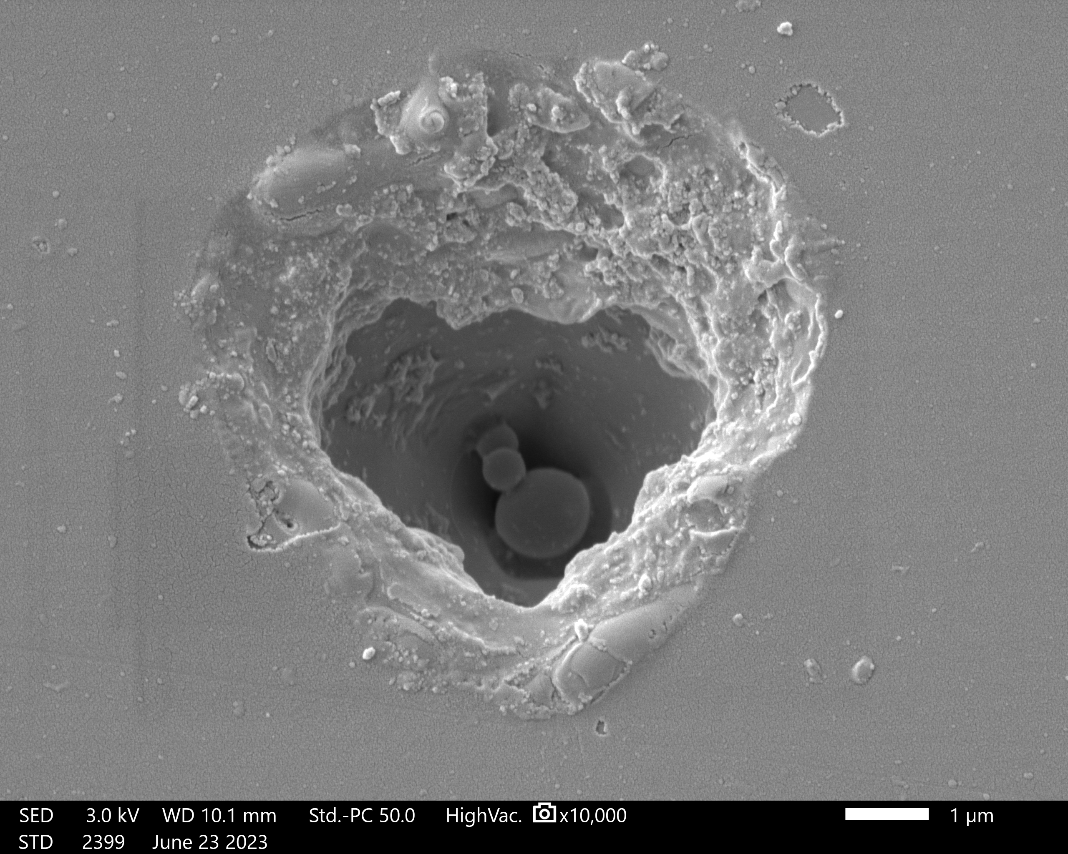
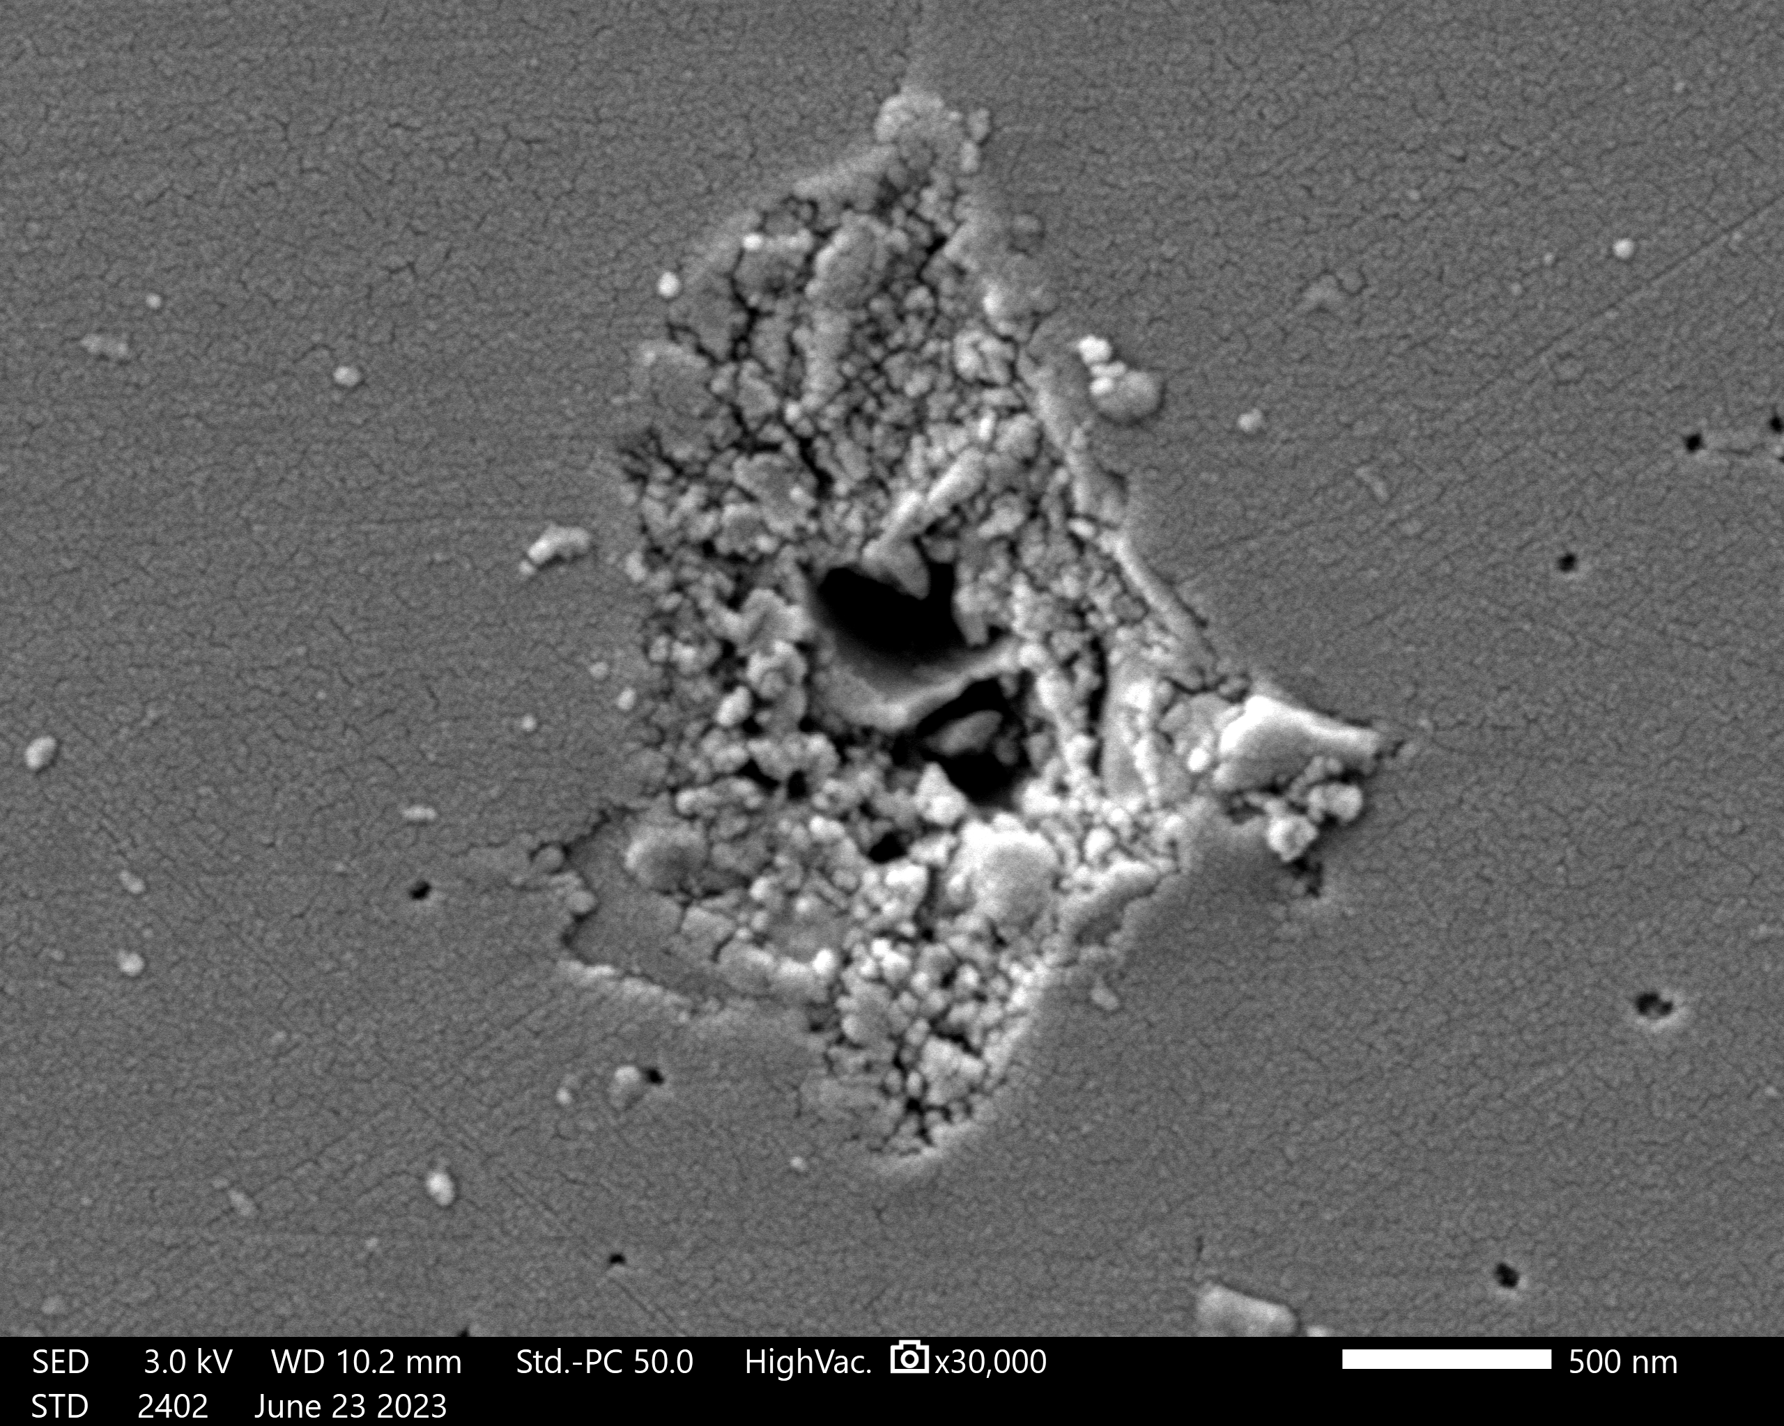



Fluid-immersion Laser Micromachining (FiLM) Using Ionic Liquids
John Allman, Brian K. Canfield, Lino Costa, Alexander Terekhov, Trevor Moeller
Laser-induced Cavitation
Cavitation is the process by which a void or cavity is formed inside a liquid. This “cavity” is devoid of the parent immersive liquid and is often in a gaseous or plasma state. In laser-induced cavitation, a plasma is generated by energy transferred into the liquid by a focused laser.
Cavitation is heavily dependent on the physical properties of the liquid.
Liquids with different densities, surface tensions, vapor pressures, viscosities, and other physical properties will cavitate differently.
Sample Imaging
Polymer Imprint Lithography
20 μm spacing between holes
Replica of hole interior
The intense energy of the focused laser vaporizes the liquid in the focal region and instantly generates a plume of plasma.
A cavitation bubble is formed and radially expands until the pressures inside and outside the bubble are equal. then the bubble begins to collapse inwards.
As the bubble collapses, a liquid microjet forms and causes additional damage to the surface. This jet can also clear any loose debris from the area.
50 µm
The samples are imaged via an SEM (Scanning Electron Microscope). This enables the substrate surface to be inspected for damage at the nanometer scale.
Polymer imprint lithography is a technique used to make a negative replica cast of the substrate surface and any features ablated in it.
Ionic Liquids Versus Other Liquids for FiLM
EMI (Ionic Liquid)
Deionized Water
BMI (Ionic Liquid)
515 nm
Laser
Immersion fluid
microjet
Plasma
Generation
Collapsing
bubble
R_{max}
P_{in} = P_{out}
500 nm
1 μm
500 nm
Glass slide
2
3
Ionic liquids as the immersion liquid for FiLM decreased the damage done to the substrate surface.
Ionic liquids have very low vapor pressures (especially compared to fluids like water).
Note the size difference of the holes between the Ionic Liquids and water
1

